Slide 1
ATAI
Advanced Technique of Artificial Intelligence
ATAI
ChongqingUniversity _{AdvancedTechniqueof}
of Technology Artificial Intelligence
Chongqing University of
Technology
Chongqing University ^{ATAI}
_{of Technology} Advanced Techniqueof
Artificial Intelligence
Chongqing University of Technology
Chongqing University of Technology
GAMC:An Unsupervised Method for Fake News Detection using Graph Autoencoder with Masking
Code : None
—— AAAI’2024
Reported by Yang Jiang
1

Slide 2
ATAI
Advanced Technique of Artificial Intelligence
ATAI
ChongqingUniversity _{AdvancedTechniqueof}
of Technology Artificial Intelligence
Chongqing University of
Technology
Chongqing University ^{ATAI}
_{of Technology} Advanced Techniqueof
Artificial Intelligence
Chongqing University of Technology
Chongqing University of Technology
Introduction
By employing the context and content of the news propagation process as the self-supervised signal, along with a feature reconstruction and contrasting task, this method circumvents the need for labeled datasets.

Slide 3
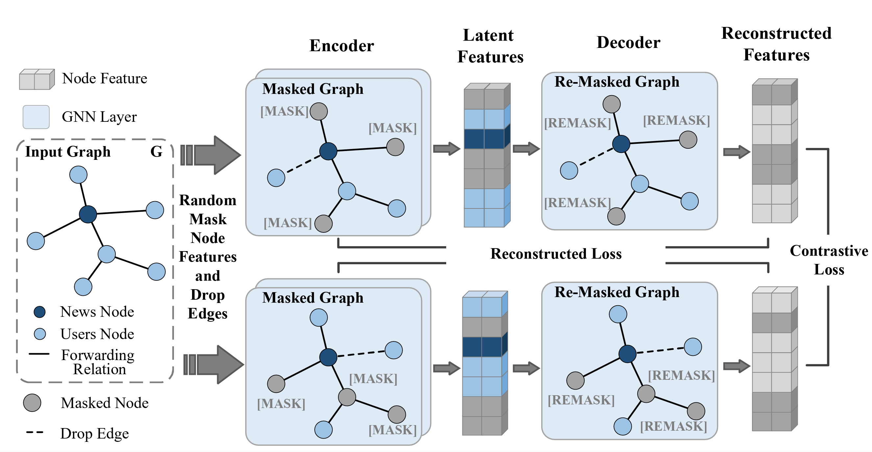
ATAI
Advanced Technique of Artificial Intelligence
ATAI
ChongqingUniversity _{AdvancedTechniqueof}
of Technology Artificial Intelligence
Chongqing University of
Technology
Chongqing University ^{ATAI}
_{of Technology} Advanced Techniqueof
Artificial Intelligence
Chongqing University of Technology
Chongqing University of Technology
Overview

Slide 4
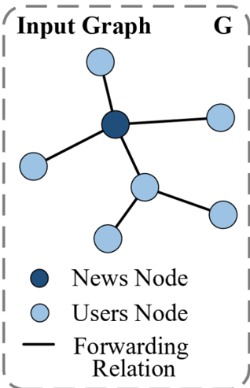
ATAI
Advanced Technique of Artificial Intelligence
ATAI
ChongqingUniversity _{AdvancedTechniqueof}
of Technology Artificial Intelligence
Chongqing University of
Technology
Chongqing University ^{ATAI}
_{of Technology} Advanced Techniqueof
Artificial Intelligence
Chongqing University of Technology
Chongqing University of Technology
Definition

Slide 5
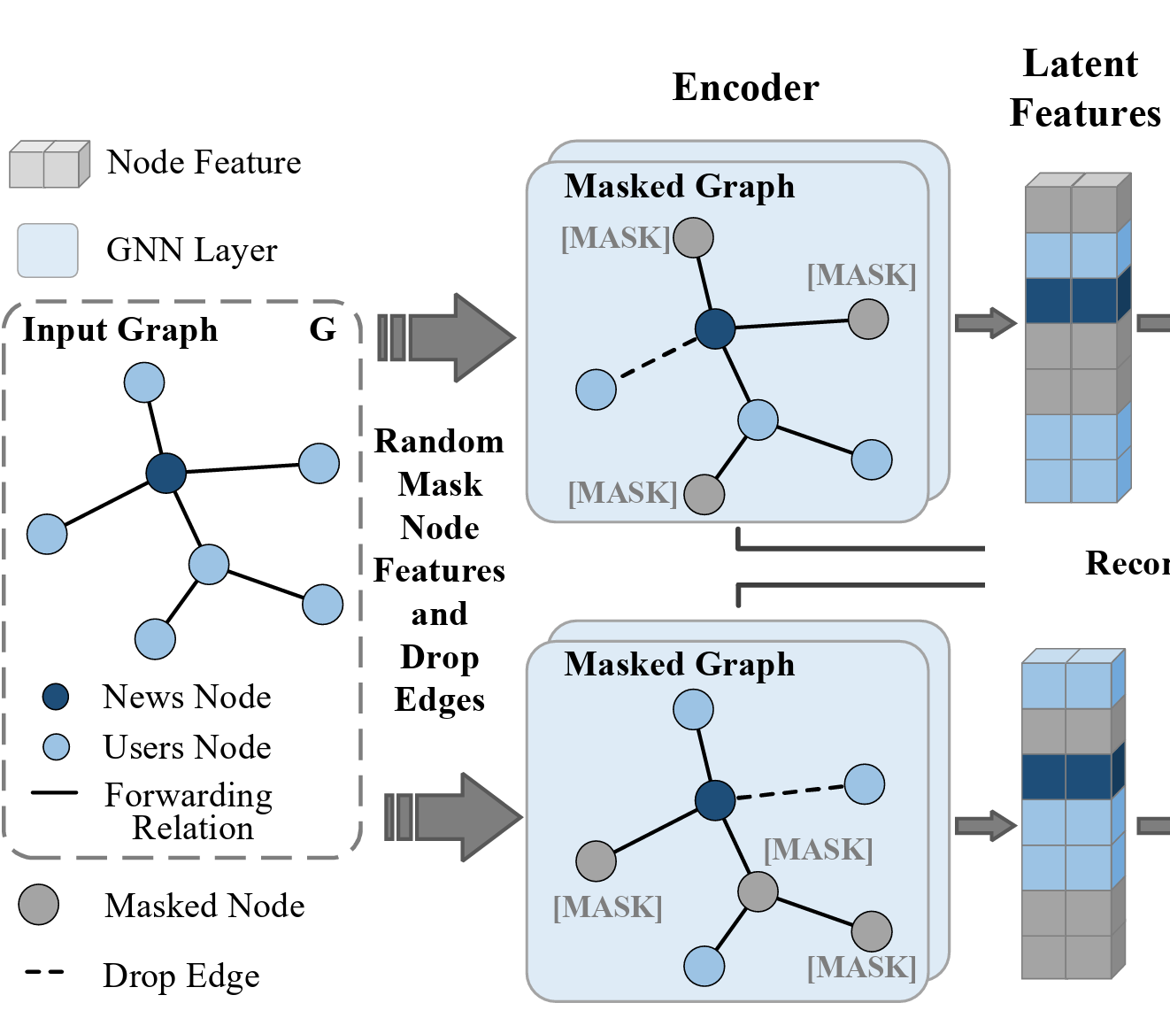
ATAI
Advanced Technique of Artificial Intelligence
ATAI
ChongqingUniversity _{AdvancedTechniqueof}
of Technology Artificial Intelligence
Chongqing University of
Technology
Chongqing University ^{ATAI}
_{of Technology} Advanced Techniqueof
Artificial Intelligence
Chongqing University of Technology
Chongqing University of Technology
Method
Data Augmentation

Slide 6
ATAI
Advanced Technique of Artificial Intelligence
ATAI
ChongqingUniversity _{AdvancedTechniqueof}
of Technology Artificial Intelligence
Chongqing University of
Technology
Chongqing University ^{ATAI}
_{of Technology} Advanced Techniqueof
Artificial Intelligence
Chongqing University of Technology
Chongqing University of Technology
Method
Graph Encoding

Slide 7
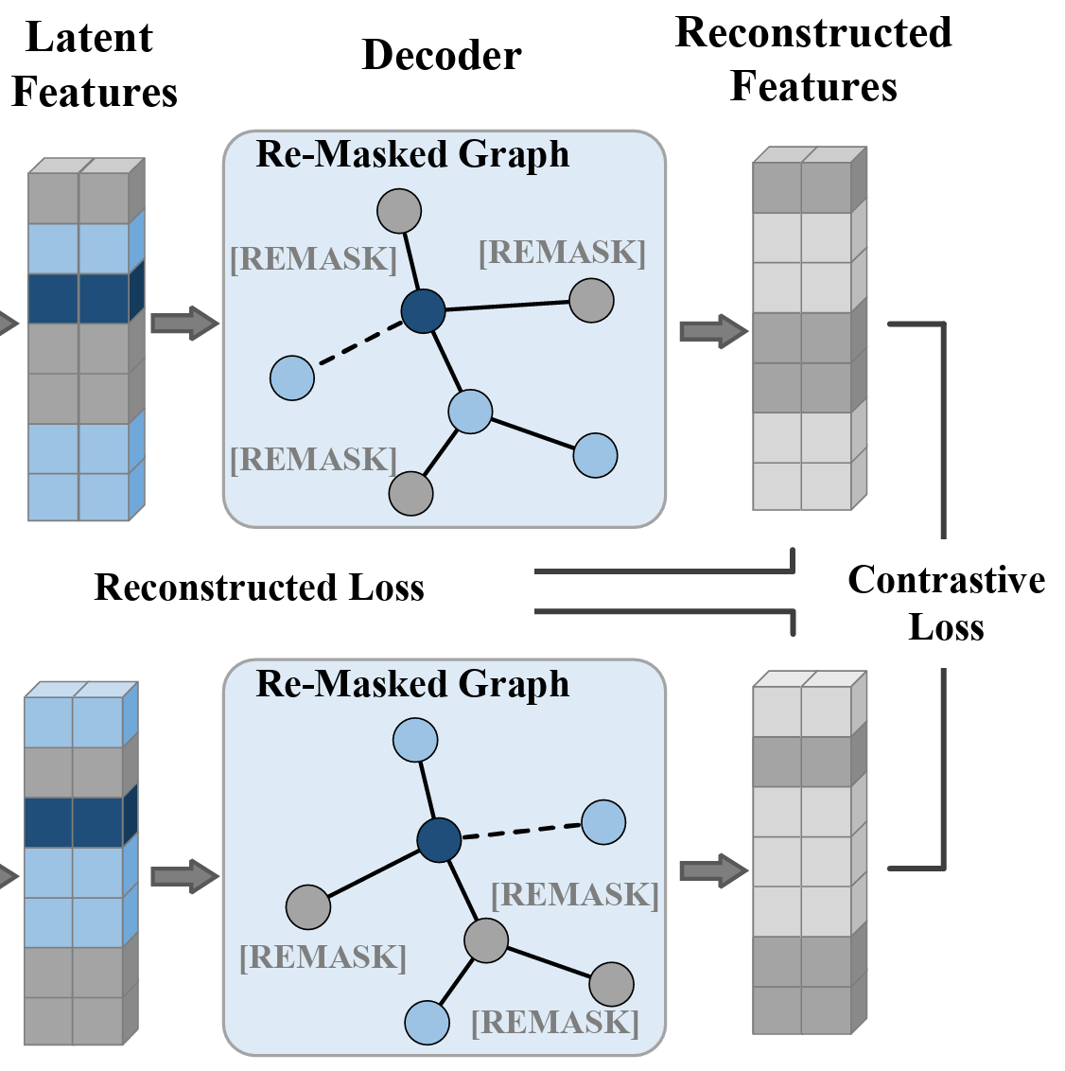
ATAI
Advanced Technique of Artificial Intelligence
ATAI
ChongqingUniversity _{AdvancedTechniqueof}
of Technology Artificial Intelligence
Chongqing University of
Technology
Chongqing University ^{ATAI}
_{of Technology} Advanced Techniqueof
Artificial Intelligence
Chongqing University of Technology
Chongqing University of Technology
Method
Graph Decoding

Slide 8
ATAI
Advanced Technique of Artificial Intelligence
ATAI
ChongqingUniversity _{AdvancedTechniqueof}
of Technology Artificial Intelligence
Chongqing University of
Technology
Chongqing University ^{ATAI}
_{of Technology} Advanced Techniqueof
Artificial Intelligence
Chongqing University of Technology
Chongqing University of Technology
Method
Loss Function

Slide 9
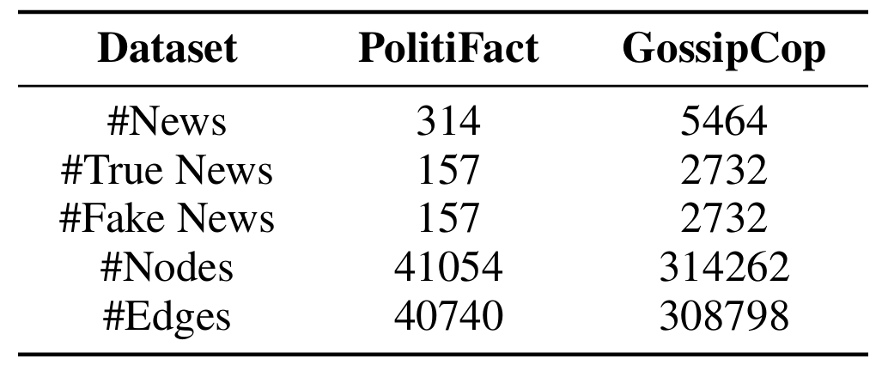
ATAI
Advanced Technique of Artificial Intelligence
ATAI
ChongqingUniversity _{AdvancedTechniqueof}
of Technology Artificial Intelligence
Chongqing University of
Technology
Chongqing University ^{ATAI}
_{of Technology} Advanced Techniqueof
Artificial Intelligence
Chongqing University of Technology
Chongqing University of Technology
Experiments

Slide 10
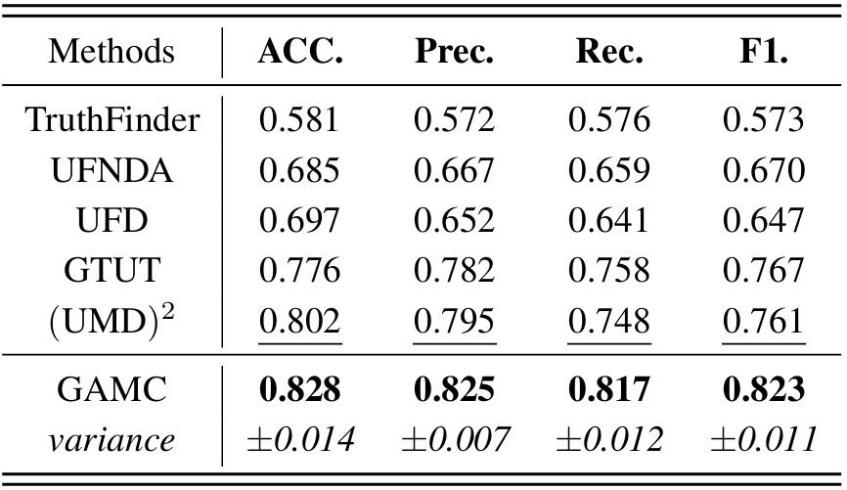
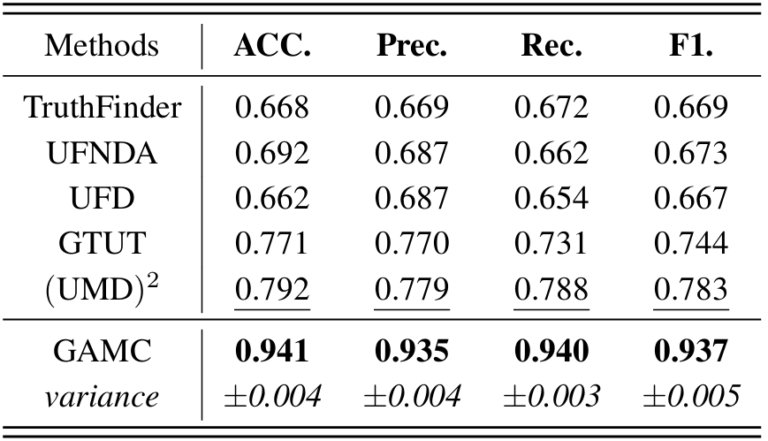
ATAI
Advanced Technique of Artificial Intelligence
ATAI
ChongqingUniversity _{AdvancedTechniqueof}
of Technology Artificial Intelligence
Chongqing University of
Technology
Chongqing University ^{ATAI}
_{of Technology} Advanced Techniqueof
Artificial Intelligence
Chongqing University of Technology
Chongqing University of Technology
Experiments

Slide 11
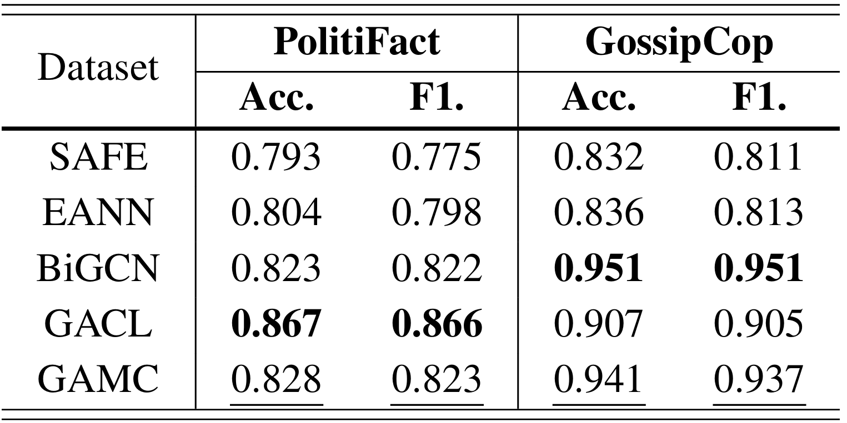
ATAI
Advanced Technique of Artificial Intelligence
ATAI
ChongqingUniversity _{AdvancedTechniqueof}
of Technology Artificial Intelligence
Chongqing University of
Technology
Chongqing University ^{ATAI}
_{of Technology} Advanced Techniqueof
Artificial Intelligence
Chongqing University of Technology
Chongqing University of Technology
Experiments

Slide 12
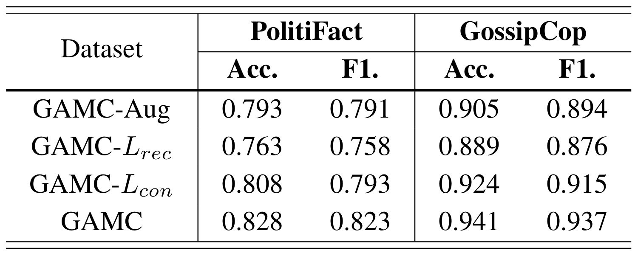
ATAI
Advanced Technique of Artificial Intelligence
ATAI
ChongqingUniversity _{AdvancedTechniqueof}
of Technology Artificial Intelligence
Chongqing University of
Technology
Chongqing University ^{ATAI}
_{of Technology} Advanced Techniqueof
Artificial Intelligence
Chongqing University of Technology
Chongqing University of Technology
Experiments

Slide 13
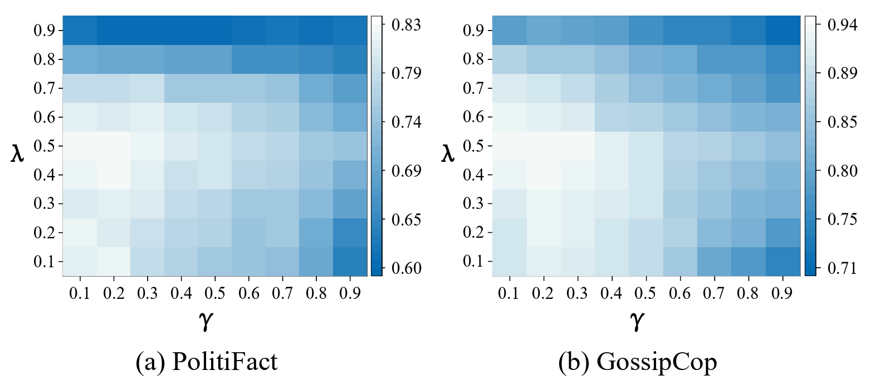
ATAI
Advanced Technique of Artificial Intelligence
ATAI
ChongqingUniversity _{AdvancedTechniqueof}
of Technology Artificial Intelligence
Chongqing University of
Technology
Chongqing University ^{ATAI}
_{of Technology} Advanced Techniqueof
Artificial Intelligence
Chongqing University of Technology
Chongqing University of Technology
Experiments

Slide 14
ATAI
Advanced Technique of Artificial Intelligence
ATAI
ChongqingUniversity _{AdvancedTechniqueof}
of Technology Artificial Intelligence
Chongqing University of
Technology
Chongqing University ^{ATAI}
_{of Technology} Advanced Techniqueof
Artificial Intelligence
Chongqing University of Technology
Chongqing University of Technology
Thanks!

